Slide 1
Technology Equipment
Kevin Snowden, State Director, Alabama
Derek Graham, State Director, North Carolina

Slide 2
Telecommunications for the School Bus
SESPTC, Charleston, WV – July, 2016
Kevin Snowden, State Director, Alabama

Slide 3
Communication: need -vs- funding
NEARLY
MORE THAN
In
funding
plummeted below 2008 recession levels.
40%
40%
34
Believe their district needs an updated communication system.
want GPS to track and monitor buses.
states

Slide 4
Communication funding
In order to get started, check with “safety and security” monies.
Some states offer funding after the first year…

Slide 5
Types of systems
Two basic types of systems:
Analog
Digital
LTE
IDEN

Slide 6
Cellular phones
Advantages:
Direct communication
Mostly “private”
Portable
Disadvantages:
Must be turned-on
Easily misplaced
Limited to one individual

Slide 7
Radios
Those that use a common tower/repeater
Advantages:
Mass communication
Great for “group” communication
Most of time, mounted…
However, some may be portable
Disadvantages:
Generally, no “private” feature
Most of time, mounted – no direct-connect with bus driver

Slide 8
Radios
Those that are self-sustained systems
Advantages:
Mass and group communication
Most of time, mounted; however, may be portable
Disadvantages:
Not many…
Just need money to pay

Slide 9
Radios
Key Benefits to Self-Sustaining Systems
Secure communications
Reliable even if cell tower goes down
Instant alerts from Public Safety
Faster response in an emergency
Accessories that allow for hands-free communication
Push-to-Talk Capability
No recurring fees

Slide 10
Radios
Features to ask for in a Self-Sustaining Systems
FEATURES
Broadband to Radio group call
Broadband to Broadband group/private calls
Broadband user presence/location
There are systems available that also work with:
Android 4.X and iOS 7.X
WiFi/3G/4G/PS LTE

Slide 11
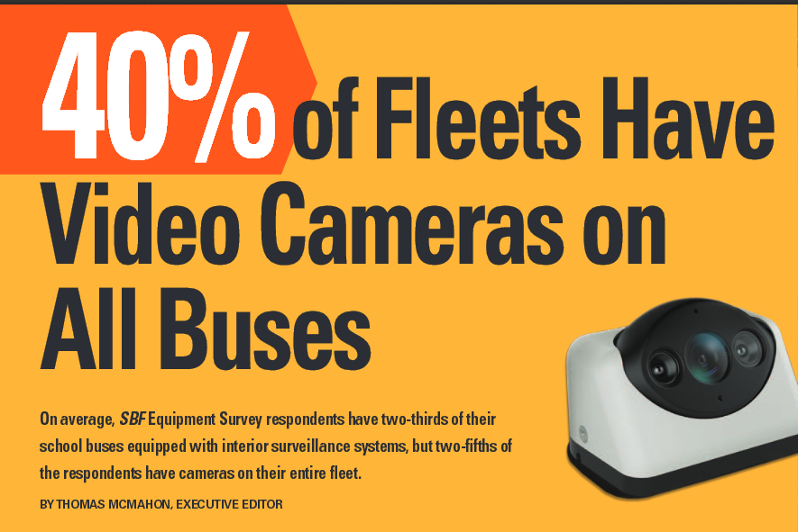

Slide 13
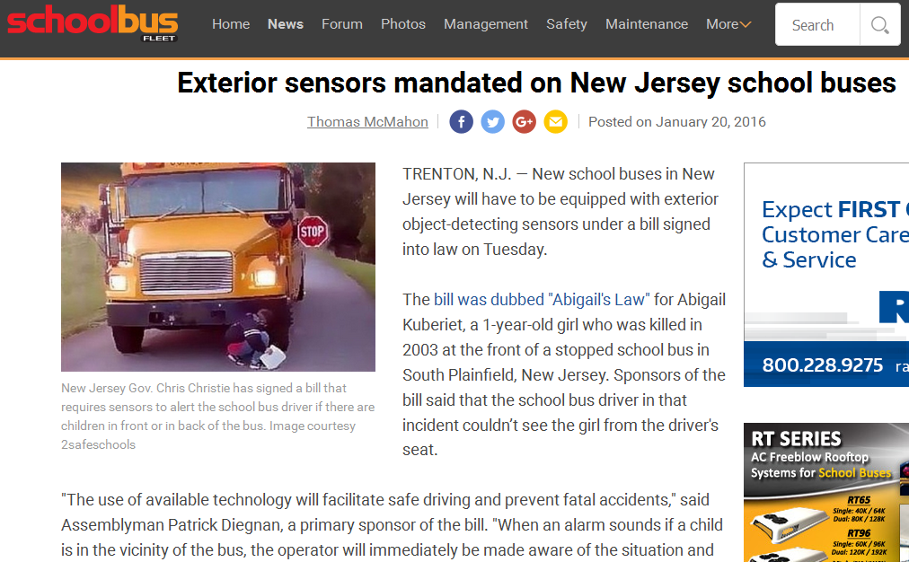

Slide 14
Exterior Sensors
SDS – New Jersey
http://abc7ny.com/news/new-sensor-safety-system-being-tested-out-on-school-bus-in-plainsboro/1159763/
http://www.nj.com/middlesex/index.ssf/2016/01/abigails_law_would_require_motion_sensors_on_schoo.html

Slide 15
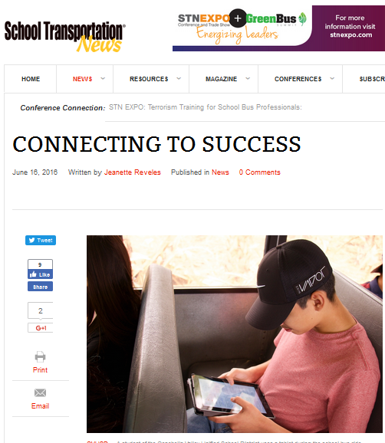
Wifi on School Buses
Coachella
Valley
USD (CA)

Slide 16
Cameras
Video Inside the Bus
Students
Driver
Outside

Slide 17
Cameras
Outside the Bus
Stop Arm Violations
Other ‘interesting’ views

Slide 19
Cameras Inside the Bus
Evolution
How Suppliers have Responded

Slide 20
Camera Placement
Traditionally…..
One in the front looking back
Altenratives
Placing cameras on the sides
New Improved Views

Slide 21
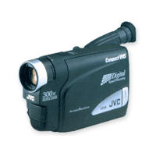
Camcorders…Single VIew

Slide 22
Two Digital Cameras – Front and Rear

Slide 23
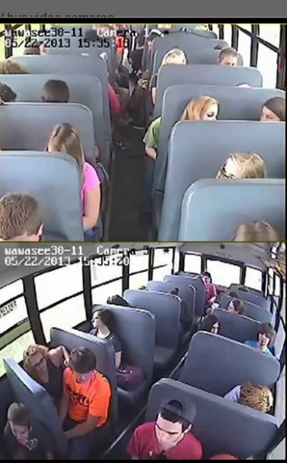
Then….One in the back looking front and one mid-ship

Slide 24
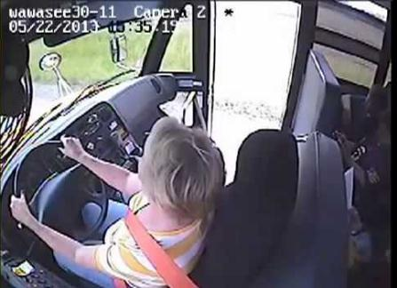
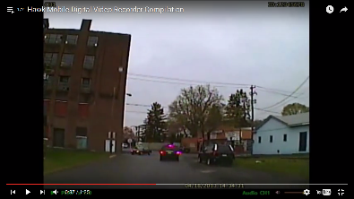
4/8 Interior Cameras – opportunities for additional views

Slide 25
Let’s look at the driver’s rear-view…..

Slide 26
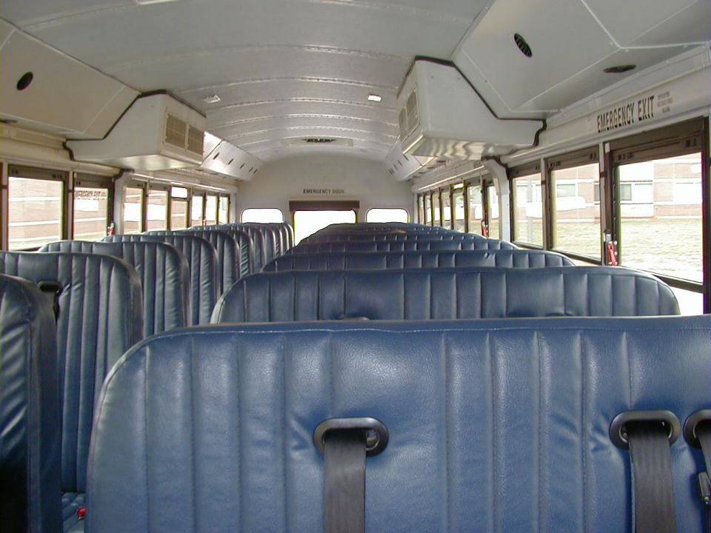
Seat Back Height

Slide 28
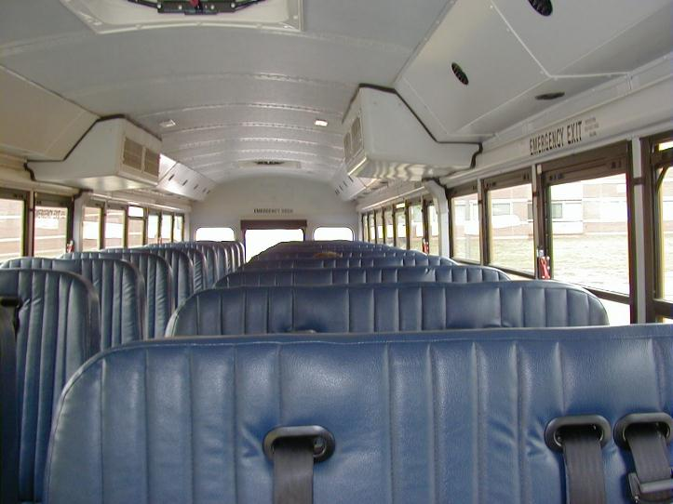

Slide 29
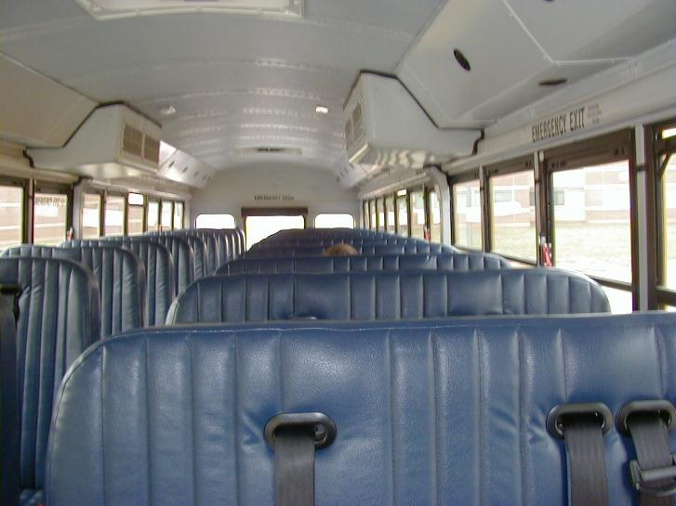

Slide 30
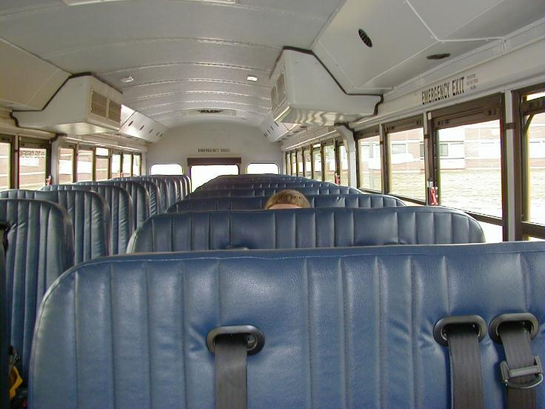

Slide 31
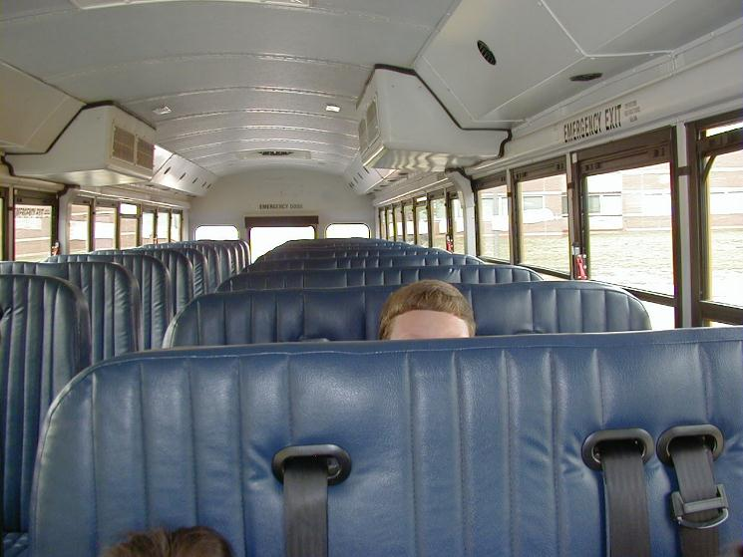

Slide 32
Two 6th graders, one 2nd grade, and one kindergarten

Slide 33
Video of overhead cameras that capture a view into the seating compartment

Slide 34
Interior Cameras – Operational Issues
Marking events
Retrieving events
Hard Drive
Flash Drive
Wireless Download
Maintenance

Slide 35
Stop Arm Violation Cameras
Used as evidence
Used to issue civil fines

Slide 37
Award Specifics
Kris Hafezizadeh
Austin Independent School District
Awarded vendor
Revenue sharing terms ($300 fine)
Full fleet install (300+ buses)

Slide 38
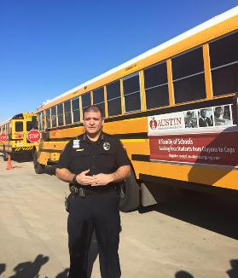
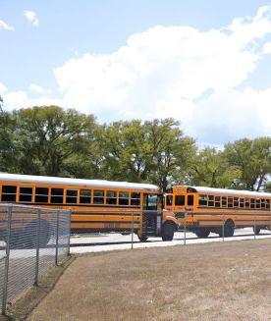
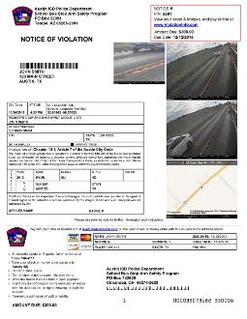
Program Details
Launch Date
January 7, 2016
30 Day
Warning Period
Violations
February 8, 2016
Press Conference
Cameras Live
Violations Mailed

Slide 39
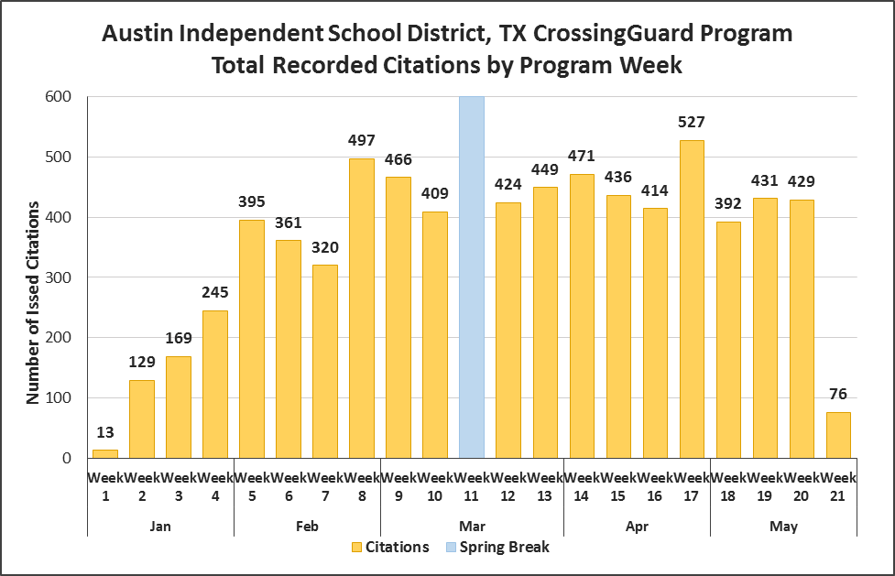
Program Results: Total Recorded Citations
7,000+ Citations: January – May 2016

Slide 40
Austin Independent School District (TX)
http://www.kvue.com/news/over-1000-school-bus-violations-issued-in-austin/54558547
Alabama new law
http://abc3340.com/news/local/new-law-allows-alabama-school-districts-to-install-stop-sign-cameras-on-school-busses
Douglas County, GA – ATS/ Automated Enforcement
https://www.youtube.com/watch?v=hs4GxKwKXos
Indiana – A prosecutor’s Skepticism
https://www.youtube.com/watch?v=l8rMfrCSww4

Slide 41
Telematics
Providing engine diagnostic information while the bus is on the road.
Identify potential problems before they turn into real problems
Similar to the way real-time GPS locations are transmitted to the operations center
OEM involvent

Slide 42
Routing and School Bus Tracking
Routing
Passive GPS
Active GPS
Actual vs. Planned
Benefits
Auditing drivers/routes
Security
Responding to parents/Defending the Driver

Slide 43
Student Tracking
RFID Cards
Finger print scanners
Retina / Iris scanning
Public debate

