Slide 1
Conflict Resolution & De-escalation Training
Notes:
Suggested time:
1 hour

Slide 2
Topics for Discussion
Listening Skills
How Do We Communicate?
What Is Conflict?
The Key Action Steps
De-Escalation
3 Guiding Principles For Every Situation
Closing The Loop

Slide 3
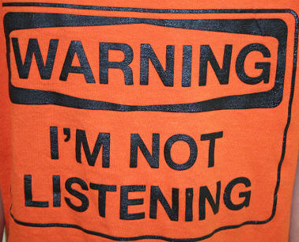
Ineffective Listening Skills
Assumptions
Boredom
[Lack of] Concentration
Disagreement
Ego-involvement
Failure to understand
Generalizations
Hearing only what you want to hear
Interruptions
Judgments
Kindness that kills
Listening to words only

Slide 4
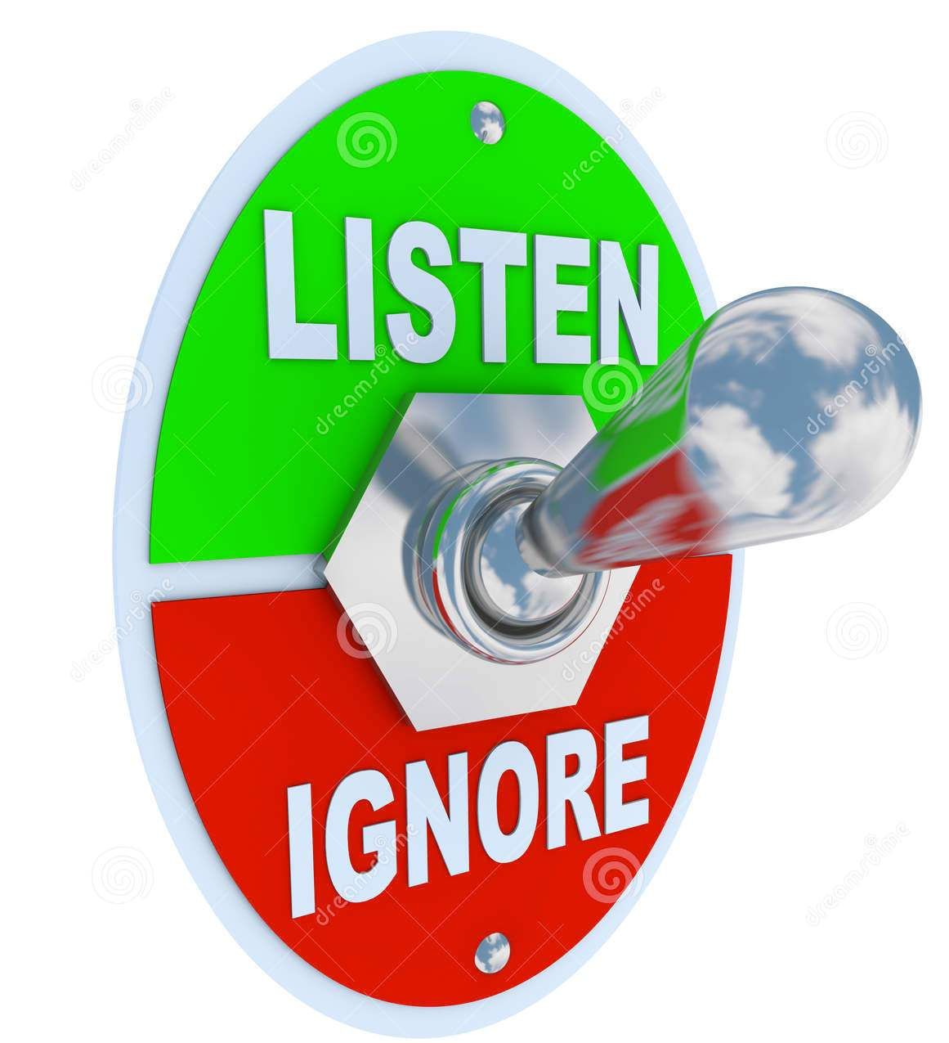
Effective Listening Skills
Ask questions only to facilitate flow
Believe what is stated is valid
Clarify confusions
Discern unspoken messages
Echo significant words or phrases
Find words and phrases for response
Give information
Help develop context and chronology
Instill quiet
Journey through narratives
Keep judgments to yourself
Listen for summaries and narratives

Slide 5
COMMUNICATION
“IT TAKES A TEAM OF PEOPLE, COMMUNICATING AND COLLABORATING WITH EACH OTHER, TO BEST PROVIDE PROPER SERVICE TO OUR CUSTOMERS”
Communicating is not what you say and do.... it is what the other person hears and see’s!
Notes:
Communication is critical and necessary. The safety and Security of our staff is crucial, and all persons involved with the district depends on effective communication between all parties.

Slide 7
How Do You Communicate?
Verbal
Language
Active Listening
Written
Notes, memos
Forms
Non-Verbal
Attitude
Confidence
Appearance
Body Language
Gestures
Facial expressions
Notes:
Everything begins with you! Being a good communicator is being a good listener.
VERBAL
Language: We communicate in many ways, primarily verbally.
Active listening :Listen to the speaker (parent, child, fellow co-worker) before answering. An active listener does the following:
Keeps eye contact with the speaker
Nods head or acknowledges conversation while person is speaking
Stops working on what they are doing while other person is speaking (shows respect)
Paraphrases and summarizes conversation using phrased like: “What it sounds like is….” “It seems that you are saying….”
Shows empathy when appropriate: “I can certainly understand your concern because………..”
Always asks what can be done and offer some solutions to a challenge: “What can I/we do to help you with….”, “Some things that might help to solve this problem are….”
WRITTEN:
Notes and Memos: Caution must be taken regarding what you put in writing. (Many districts require a supervisor’s prior approval).
Forms: Just the facts or the required information should be written….do not give your personal opinion. If you have difficulty spelling or writing your thoughts clearly, seek assistance.
NON-VERBAL: Did you know that 93 % of all communication is non-verbal?
Attitude: The most frequent complaints regarding bus operators and attendants have to do with poor attitude. Such comments include unfriendly, too loud, won’t talk to me, won’t talk to my child, and unhelpful. Remember that you are an ambassador of our school district.
Confidence: The way in which you present yourself to others can show that you have competence in your job duties, that you are comfortable speaking or interacting with others, and that you are informed and skilled.
Appearance: You should dress according to District guidelines. Your professional appearance says much about you.
Body Language: This ties in closely with attitude. Sometimes you do not have to say anything but as the old saying goes, “a picture is worth a thousand words.” Your smiles, nods, gestures, and facial expressions all affect your non-verbal message to whom you are speaking to.
WHAT IS YOUR COMMUNICATION STYLE? Look around the room. What messages do you see via body language?

Slide 8
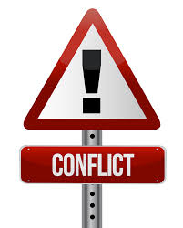
What Is Conflict?
Conflict is defined as a “prolonged open warfare, a state of disharmony; clash, to be opposed; differ.”

Slide 9
Types Of Conflict
Differences – makes life interesting
Disagreement – preferences and priorities
Problem – causes some consequences
Dispute – desire to resolve the problem
Conflict – Win or Lose
Violence – damage or harm
War – physical or emotional harm
Notes:
Differences: People are different by birth; differences make life interesting. Imagine if all people preferred the same food, dress, profession ….Difference in itself is not a cause for conflict, but differences can be a source for conflict.
Disagreement: Disagreement begins when people express their preferences and priorities in comparison with other people’s preferences and priorities. Disagreement can be harmless and have no consequences, with no need for resolution.
Problem: Problems occur when disagreements or differences cause some consequences for at least one party. Problems could be avoided, but they are disturbing, costly or both. People’s daily lives are a series of solved problems. Unresolved problems can result in escalation and require crisis resolution.
Dispute: Disputes occur when more than one party acknowledges the differences and the problem. In a dispute, at least one party expresses its desire to solve the problem.
Conflict: In a conflict, all parties are willing to invest in the escalation of the dispute in order to “Win” or not “Lose”. In a conflict, the parties feel that their goals are incompatible with the goals of the other party.
Violence: At this stage, the parties act to damage, hurt, or exploit resources in order to “Win” or not “Lose” the conflict. Violence is not only physical; it can be emotional or psychological.
War: Parties are so engaged in their violence that they use violence to damage the other side’s source of power. In this stage, parties often forget or ignore their basic differences and the developments that led them to war.

Slide 10
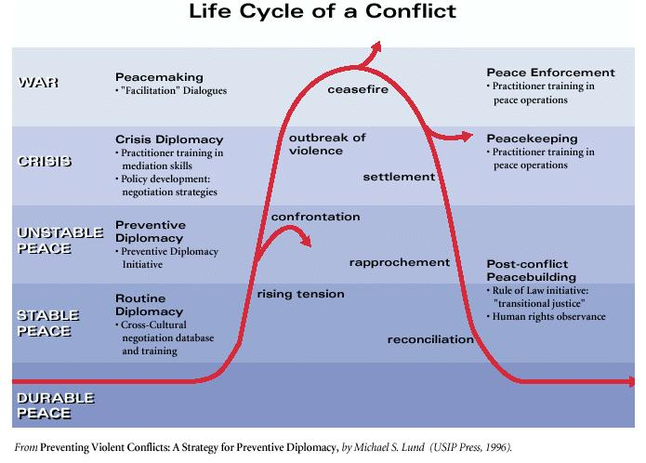

Slide 11
Situations That Can Result In Conflict
Differences of opinion on what to do, how to do something, or who should do it.
Resentment about differences in workloads or commitment to a project or goal.
Differences in style, work habits or performance issues.
Failure by everyone involved to follow agreed-upon procedures or standards.
Lack of sufficient resources or role clarity.
Feelings of disrespect, distrust, lack of support or not being heard.

Slide 12
What Is Conflict Resolution?
Conflict Resolution is defined as a positive process whereby individuals resolve issues in an informal or formal atmosphere or where issues are resolved as part of the ongoing interaction between individuals. Resolving conflict involves acknowledging, validating and understanding each other’s perspectives.

Slide 13
The Key Action Steps
Identify the problem and/or define the issue.
State the facts not opinions
Gain agreement on the issue
State your needs and the other persons needs
Avoid positional statements
Listen carefully to the needs that are expressed by others
Brainstorm ideas to look for possible solutions
Discuss positive constructive alternatives to meeting the needs
Be flexible and open-minded
There are no wrong answers
Evaluate options
List the pro’s and con’s for each possible solution
Play the “what if” game

Slide 14
The Key Action Steps
Select the best possible solution that will resolve the conflict
Agree jointly on a specific path of resolution
Decide who will be responsible for specific actions
Implement the selected solution
Establish a timetable to implement the change
Be flexible and talk it through
Follow-up action
Monitor progress to determine if the solution is working
Don’t be discouraged if breakdowns occur
Visit other possible solutions if necessary and start the cycle over again
Communicate effectively
The best way to resolve conflict is to get everyone to buy into the solution
Keep everyone involved in the discussion and progress of the solution
Praise the success of the change to all parties involved.

Slide 15
De-escalation
Manage yourself first before managing others
Alarm Reaction: Freeze, Flight, Fight, Fright
Anger is one letter short of Danger
Stay Cool, Calm and Collective
Stress Cycle

Slide 16
De-escalation
Unplug the power struggle: One response does not fit all
Ask the person why they are upset or what they wish to achieve
Listening sends a signal to the escalated person that you are interested in supporting them
Work together; not against each other

Slide 17
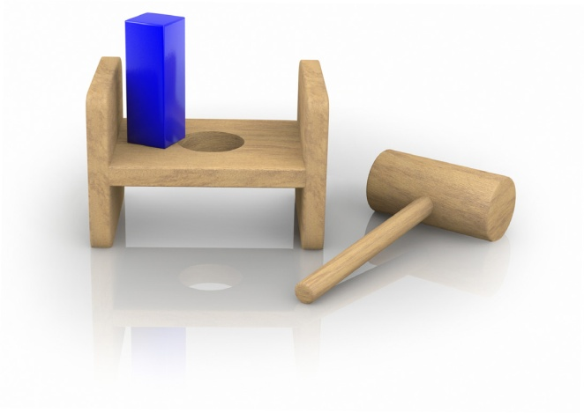
De-escalation
Making it stop does not make it stop
Behavior is a form of communication
Forcing them to stop by physical intervention is not the solution

Slide 18
De-escalation
Postvention Prevents Problems
Prevention is the preparation before an event to ensure it doesn’t happen (theft, fire, disease, bullying)
Postvention is what you learn after an event that allows you to prevent it from happening again
The best problems are the ones you don’t have anymore

Slide 19
De-escalation
Inside-Out Change:
Changing your way of thinking and responding in order to make a difference in the situation at hand
Keep an open mind
Listen

Slide 20
3 Guiding Principles For Every Situation
Meet the needs of the person that you are dealing with.
Meet their individual needs, their needs in that moment as well as their long-term needs
Reflect respect and dignity towards the people you are dealing with.
No matter what this person is calling you or how they are inconveniencing you, the lack of dignity or respect will not help you productively resolve the situation.
It is always the right response to maintain the safety of everyone involved.

Slide 21
Closing The Loop
Clear summaries
Commit to the actions agreed upon
Thank everyone
Schedule follow-up meetings or calls
Remember your Effective Communication Skills

Slide 22
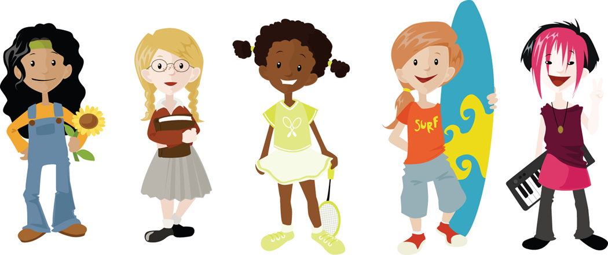
Effective communication skills cost nothing but the rewards can be great for you and your customers.
Notes:
Take the extra time to practice effective communication techniques. It can improve your relationship with your customers. Everyone will reap the benefits.

