Slide 1

New Director Expectations
Southeastern States Pupil Transportation Conference
Charleston, WV July 10, 2016
Presented By:
Charlie Hood, Executive Director
NASDPTS

Slide 2
WHOSE Expectations?
Self Expectations
Others-
  Customers
  Clients
  Anyone we serve

Slide 3

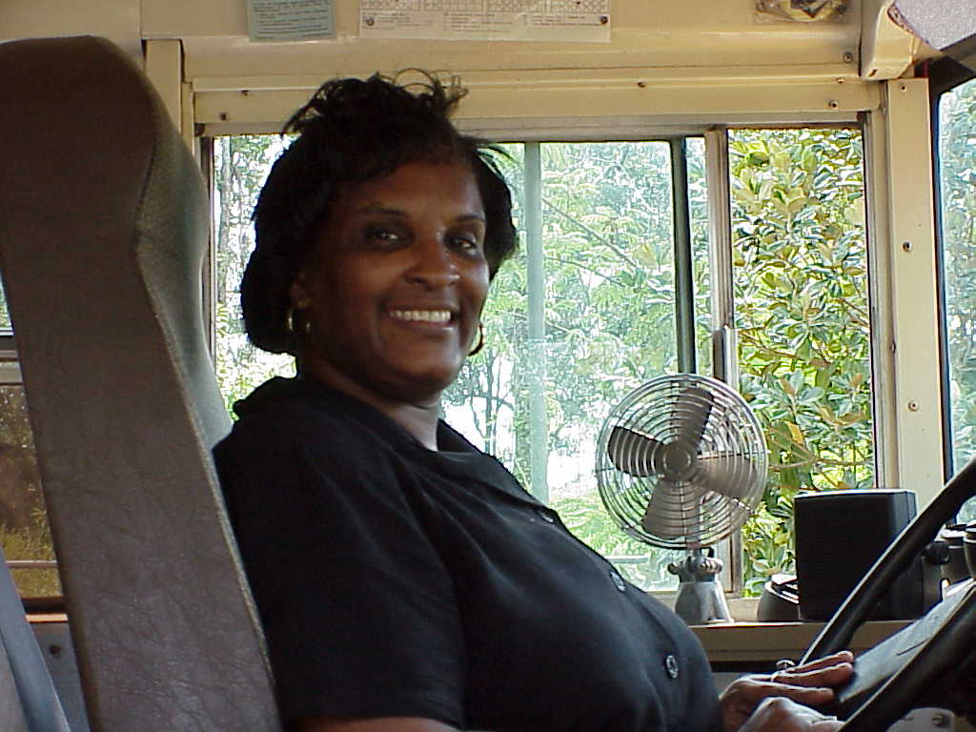
Our Customers
It’s a long list!:
  Students
  Parents
  Superintendent
  School board, state board, legislators
  Employees
  Colleagues
  Media
  Your boss

Slide 4

Start by learning “the rules”
Federal regs and guidelines
State and local laws
State and local rules
School board policies
Transportation SOPs
Best practices and guidelines

Slide 5
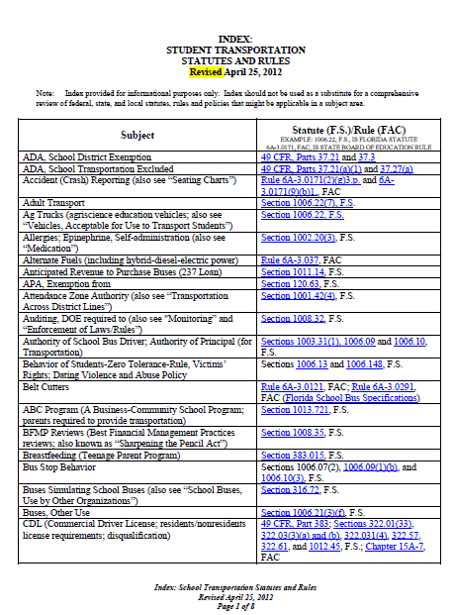

Slide 6


We are all students
Seek information and professional development through:
  Conferences
  Webinars
  Websites
  Trade publications (School Trans. News; School Bus Fleet, School Trans. Director)
  )

Slide 7


Make friends and pick brains
Fellow transportation professionals
School principals and staff
National associations (NASDPTS, SESPTC, NAPT, NSTA, etc.)
State associations (e.g., WVAPT)
State directors

Slide 8
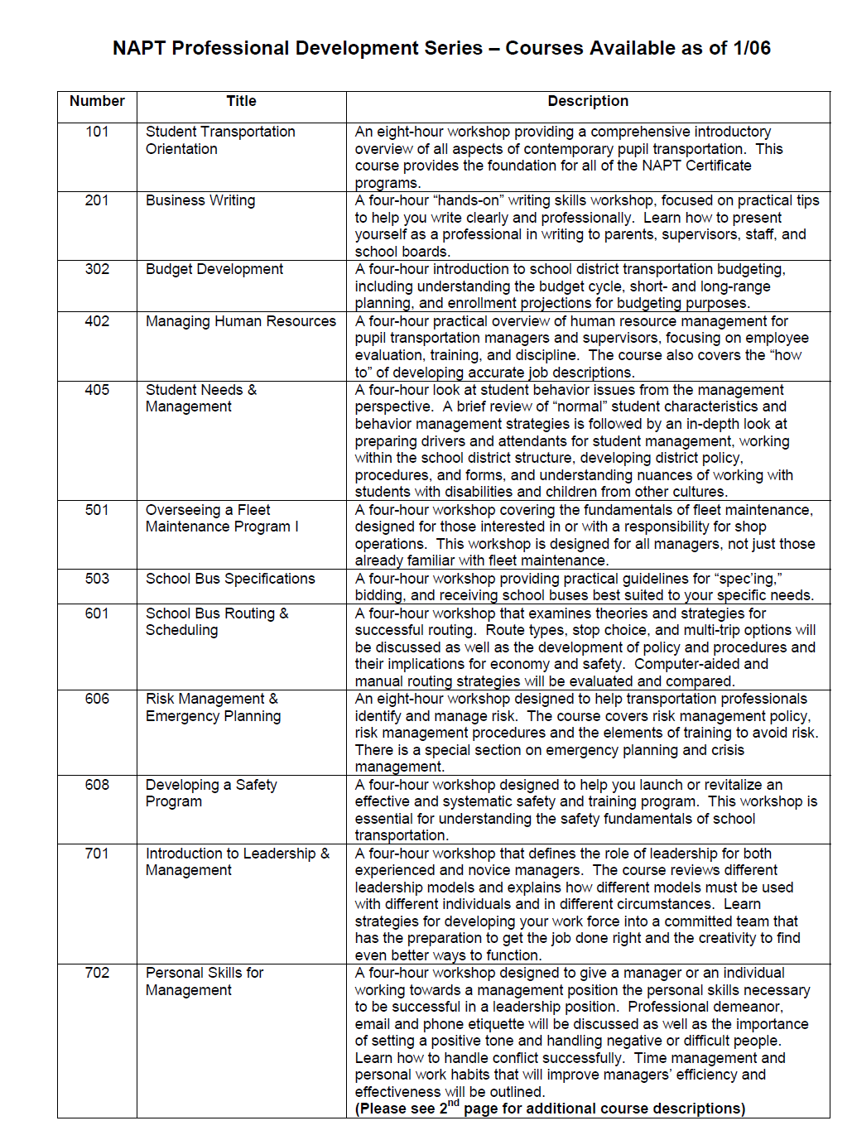

Slide 9
Meetings and Relationships
CFO and staff
Facilities and Maintenance
School staff and administrators
Charter schools coordinators
Homeless liaisons
Special ed administrators
Labor relations and unions

Slide 10
Meetings and Relationships
  Dept. of Children and Families
  Risk managers
  Federal agency contacts (NTSB, NHTSA, FMCSA, HHS, US Ed. Dept., EPA, TSA)
  Public Information Officers
  Media Contacts

Slide 11

Industry Suppliers
  OEM bus companies and dealers
  Specifications engineers
  Service and parts reps
  Component suppliers (e.g., A/C, stop arms, wheelchair lifts)
  Service providers (e.g., routing software, IT, communications)

Slide 12
Get (and stay) organized!
  Develop system for email filing and retrieval
  Develop shared network drive for work-related files (and require use)
Keep contact lists (and keep them up to date)
Develop fact sheets

Slide 13
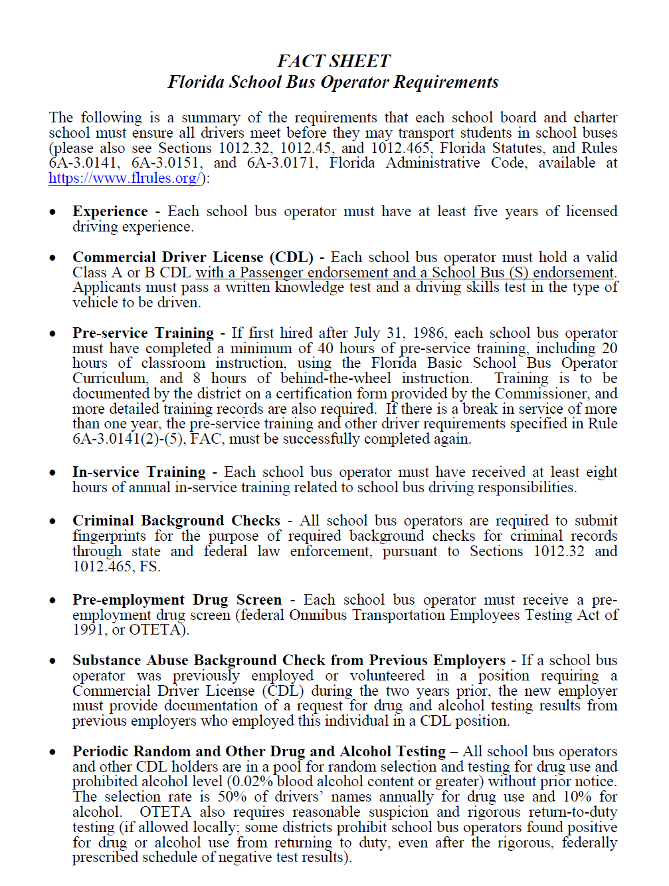

Slide 14
FAQs (and *FCs)
Student capacity (overcrowding)
Eligibility distance (no transport)
Sex offenders (on my child’s path)
Drivers (my child wouldn’t do that)
Stop locations (at my house/not at my house)
*Frequent Complaints

Slide 15
Reasonable Walking Distance…
6A-3.001 Basic Principles for Transportation of Students.
(3) A reasonable walking distance for any student who is not otherwise
eligible for transportation pursuant to Section 1011.68, Florida Statutes,
is any distance not more than two (2) miles between the home and school
or one and one-half (1 1/2) miles between the home and the assigned bus stop.
Such distance shall be measured from the closest pedestrian entry point of
the property where the student resides to the closest pedestrian entry
point of the assigned school building or to the assigned bus stop.
The pedestrian entry point of the residence shall be where private property
meets the public right-of-way.
The district shall determine the shortest pedestrian route whether or
not it is accessible to motor vehicle traffic.

Slide 16
Length Of Time On Board The Bus…
6A-3.0171 Responsibilities of School Districts for Student Transportation.
Each school district shall exercise specific powers and responsibilities, as follows:
(6) Routes and schedules.
(c) To plan routes, so far as practicable, so that no
elementary student shall be on a bus more than fifty (50)
minutes or secondary school student more than one (1)
hour during the morning or evening, and so that no more
than an hour and one-half will elapse between the time
the student boards the bus and the time school begins,
or the time school closes and the student leaves the bus
in the afternoon, and to arrange proposed routes which,
insofar as possible, are free from major hazards.

Slide 17
Hazardous Walking…
1006.23 F.S. Hazardous walking conditions.— (1) DEFINITION.—As used in this section, “student” means any public elementary school student whose grade level does not exceed grade 6.
(2) TRANSPORTATION; CORRECTION OF HAZARDS.— (a) It is intended that district school boards and other governmental entities work cooperatively to identify conditions that are hazardous along student walking routes to school and that district school boards provide transportation to students who would be subjected to such conditions. It is further intended that state or local governmental entities having jurisdiction correct such hazardous conditions within a reasonable period of time.
(b) Upon a determination pursuant to this section that a condition is hazardous to students, the district school board shall request a determination from the state or local governmental entity having jurisdiction regarding whether the hazard will be corrected and, if so, regarding a projected completion date. State funds shall be allocated for the transportation of students subjected to such hazards, provided that such funding shall cease upon correction of the hazard or upon the projected completion date, whichever occurs first.
(3) IDENTIFICATION OF HAZARDOUS CONDITIONS.—When a request for review is made to the district school superintendent or the district school superintendent’s designee concerning a condition perceived to be hazardous to students in that district who live within the 2-mile limit and who walk to school, such condition shall be inspected by a representative of the school district and a representative of the state or local governmental entity that has jurisdiction over the perceived hazardous location. The district school superintendent or his or her designee and the state or local governmental entity or its representative shall then make a final determination that is mutually agreed upon regarding whether the hazardous condition meets the state criteria pursuant to this section. The district school superintendent or his or her designee shall report this final determination to the department.

Slide 18
Sexual Offenders/Predators
In 2004, SB120 changed the requirements regarding bus stop locations in relation to residences of certain Sexual Offenders.
Bus stops can not be placed within 1000 feet of the residential address of a qualifying Sexual Offender.
Only offenders convicted of certain types of crimes against persons under age 18 and released from prison under “Conditional Release Supervision” qualify.
Many parents believe that all offenders/predators qualify, but that is not true.
Detailed definition of “Conditional Release Supervision” can be found located within the SB120.
Clarifying documentation from FDOE and the Florida Department of Corrections (FDOC) can be obtained by sending an email to the School Transportation Management Office at FDOE.
Information on individual offenders/predators and their current status can be found in the Florida Department of Law Enforcement (FDLE) Sexual Offender & Predator Database at www.offender.fdle.state.fl.us/offender/Search.jsp.

Slide 19

THE LIST
(just a smattering of what’s on your plates as directors)
Student Management (discipline, bus rules, bullying, etc.)
Charter Schools
Child Abuse (recognition and reporting)
Special Programs- IDEA, McKinney Vento, Title I, PreK

Slide 20


Slide 22
THE LIST
FERPA, Confidentiality, Video Systems (policies and compliance)
Driver Requirements (licensure, training, and qualifications)
Technicians and Inspectors (training and certification)
Emergency Management (disaster plans, evacs, active shooters, etc.)

Slide 24
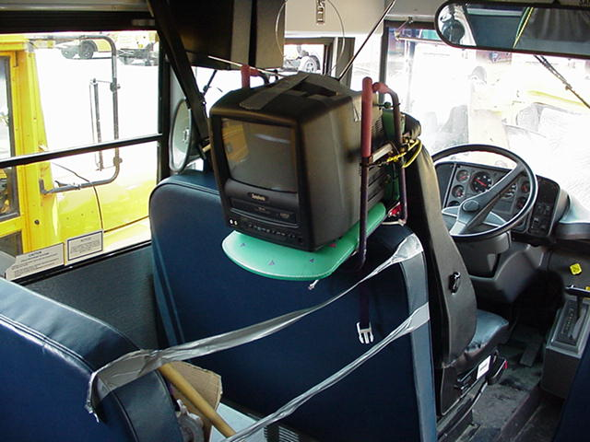

Slide 25

THE LIST
Environmental Management (A/C, hazmat, fuel, clean air grants)
Bus compound and shop safety
Radio Communications and Protocols
Bus Procurement and Specifications

Slide 26
THE LIST
Bus Inspection, Maintenance, and Repair
Personnel Mgt., Labor Relations
Emerging Tech
Financial Management (payroll, accounting, budgeting, state and local funding systems)

Slide 27


Slide 28

THE LIST
School Bus Routing (safety, cost control, and optimization)
School Bus Stops (selection and review processes)
Media Relations
Vehicle Usage Issues (and other modes)

Slide 29


Slide 30
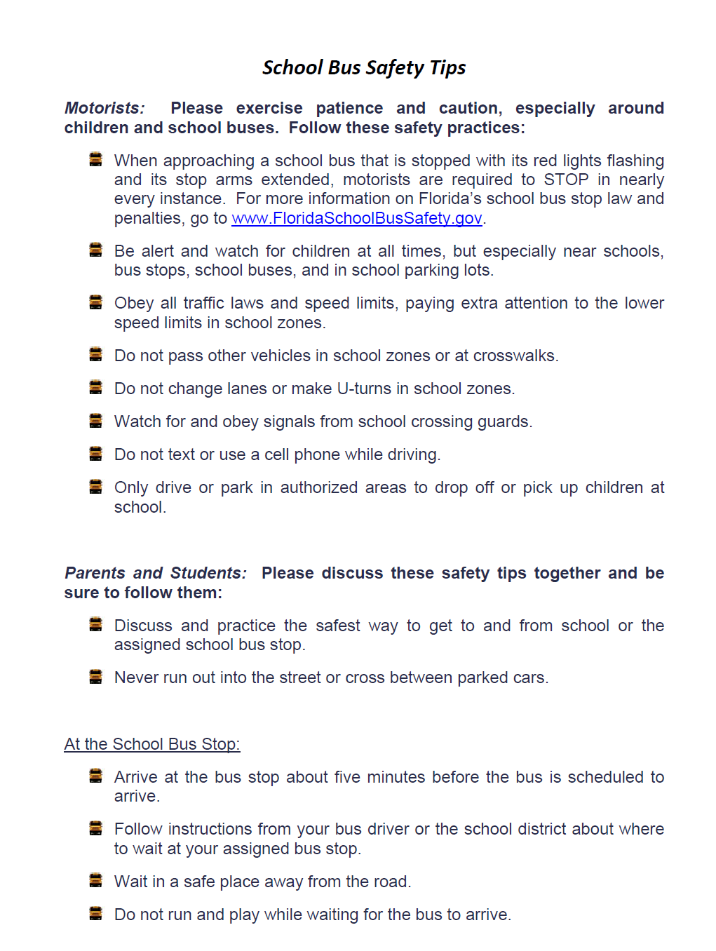

Slide 31
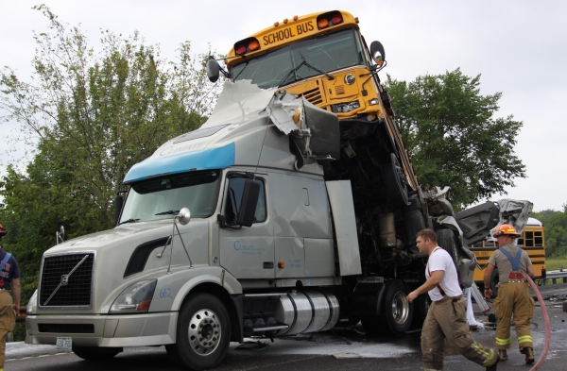

THE LIST
Special Events (NSBSW, LTB, employee events)
Accidents, Investigations
Transportation Security
School Loading Zones
School Bus Evac Drills
Rider Safety Instruction

Slide 32


Slide 33
Set the example—
Train, meet, assist, and collaborate with everyone in your professional circle

Slide 34
Any other
questions
for discussion?

Slide 35
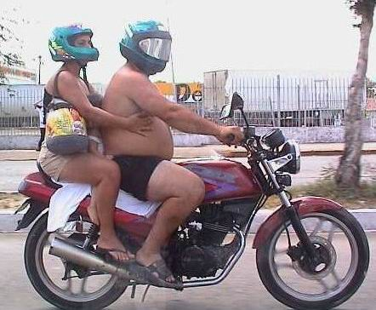
We will learn what to do . . .
And what not to do!

Slide 36
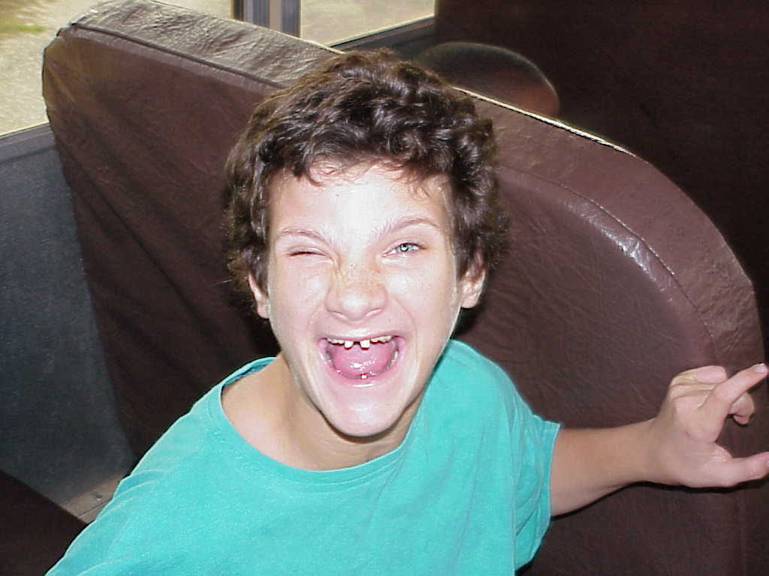
Thank you!

Slide 37
Charlie Hood, Executive Director, National Association of State Directors of Pupil Transportation Services (NASDPTS)
ExecDir@nasdpts.org
850-274-4308
www.NASDPTS.org

