Slide 1


Safety Concerns for School Bus Stop Selection
66th Annual Southeastern States Pupil Transportation Conference
Charlie Hood, Executive Director
NASDPTS
July 12, 2016

Slide 2
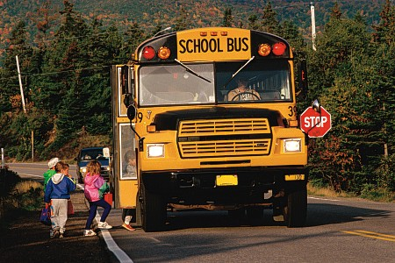
SCHOOL BUSES ARE THE SAFEST WAY TO GET TO SCHOOL!
However – Children who ride school buses are most vulnerable while walking to and from bus stops, waiting at stops, and loading or unloading from the bus.

Slide 3

Family Sues Over School Bus Stop Death
A school system’s "culture of carelessness" led to a girl's fatal walk across a busy highway, the suit says.
Rebecca, a High School student, was struck Oct. 8 as she crossed McMullen-Booth Road with her older sister, Mary, and another student. Moments earlier, they had been let off at a school bus stop that forced them to cross a busy, multilane road.
A long-standing district directive prohibited district routers from assigning such stops.
An investigation found that hundreds of additional stops also violated the directive.
It alleges that the district set up unsafe bus stops and failed to train employees properly, replace incompetent employees and use available technology to make stops safer.

Slide 4

What Can We Do To Ensure Our Stops Are the Most Reasonably Safe?
Develop Your Criteria/Guidelines (consider a stop safety review committee)
Inspect and Document Your Stops –
  When Creating A New Stop,
  Annually, and,
  When Investigating A Stop Safety Concern/Complaint
Maintain Historical Records/Documentation

Slide 5
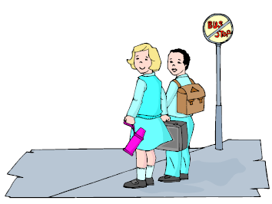
Prerequisite Considerations for Inspecting Stop Locations
Review any existing district and state policies for locating stops that discuss:
  Speed limit restrictions
  Proximity of sexual offenders
  Presence of construction, traffic, commercial driveways, lack of sidewalks, or other agreed hazards along walk routes to stop
  Available space and any required setback
  Student crossings/roadway types
  Other considerations in your policy???

Slide 6
Some States’ Policies
Alabama- ideally 500 ft. visibility
Georgia- recommends min. 300 ft. visibility; room for students to wait 12 feet or more off roadway; not located within 30 ft. of stop sign or traffic signal; no closer than .1 mile; students may not cross more than two lanes
Arkansas- no required or allowed student crossing on multi-lane highways
Florida- “most reasonably safe locations”

Slide 7
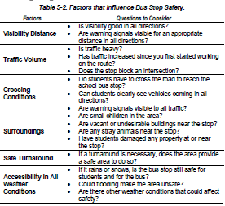
Some States’ Policies
Texas:

Slide 8
Student Loading and Unloading
Does your district train all drivers on the required standard procedure for the entire student stop sequence (from approaching to leaving the stop)?
Is the training documented thoroughly?
Have students received documented training?
Are drivers monitored to ensure they are following procedures (stopping only at approved stops; employing the required student loading/unloading procedure)?
Do your procedures support and encourage bus drivers to report student loading/unloading hazards?

Slide 9
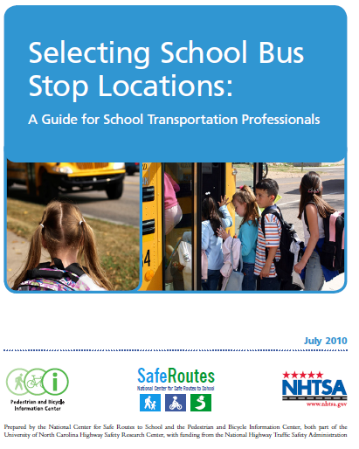

Slide 10
National Guidelines—from “Selecting School Bus Stop Locations”
http://www.nhtsa.gov/staticfiles/nti/buses/pdf/SelectingSchoolBusStopLocations.pdf
Pick routes on streets with lower traffic volumes and lower speeds.
Minimize or avoid multi-lane roads where pedestrians are most at risk of injury.
Pick roads with sidewalks or designated pedestrian paths separate from the roadway and traffic. If these are not available, pick roads with sufficient space to walk along the roadway to reach the stop.
Avoid or limit stops that require the school bus to make a left turn anywhere along the route.
Avoid stops that require backing up. If backing up is unavoidable, pick up students before backing. During the afternoon return trip, drop off the students only after backing up and being in position to drive forward.

Slide 11
National Guidelines—from “Selecting School Bus Stop Locations”
Avoid railroad crossings along the bus route. If it is impossible to avoid crossings, signage and railroad crossing arm protection should be present.
Select stops that provide sufficient visibility for both pedestrians and drivers. There needs to be enough sight distance so drivers, bus drivers and students waiting at the stop all can see each other. There are no standardized distance measures that provide sufficient visibility nor are there formulas for computing an appropriate sight distance, but the following can impact sight distances:
  o Sunrise/sunset times (Try to avoid placing stops where vehicles will be facing into the sun at pick-up or drop-off times.)
  o Curves and hills
  o Trees and other vegetation
  o On-street parked cars and approaching vehicles
  o Snow drifts from snowplows

Slide 12
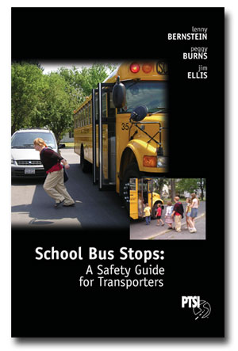
Additional Resource To Assist You With Your School Bus Stops
School Bus Stops:
A Safety Guide for Transporters
Copies can be obtained through:
Pupil Transportation Safety Institute
www.ptsi.org
315-475-1386

Slide 13
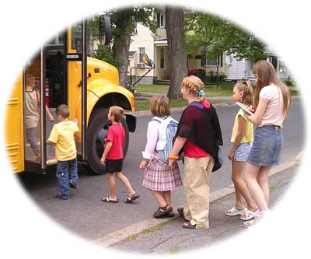
When Inspecting Stop Locations
Document:
  Who did the inspection?
  Specific location?
  Day, date, time?
  New stop, annual inspection, or based on report of potential hazard or issue?
  Traffic conditions?
  Light conditions?
  Physical characteristics and layout (preferably include digital photo files)

Slide 14


Determining Most Reasonably Safe Stop Locations (for discussion)
When assessing the visibility and sight distance of the stop, should the district consider:
  Number of feet of visibility in either direction?
  What that sight distance should be (min.)?
  Presence of natural or man-made sight barriers:
    Landscaping (trees, shrubs, rocks, etc.)--make sure you check when foliage is full
    Road curvature, horizontal or vertical (e.g., crest of hill)
    Signs or buildings
    Others???
  Lighting- natural or artificial
# of students at stop and size, setback
of student waiting area

Slide 15
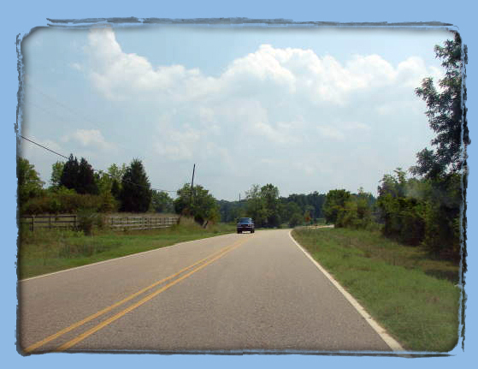
Notes:
An example of a two lane roadway.

Slide 16
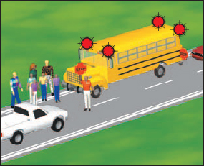
Determining Most Reasonably Safe Stop Locations (for discussion)
Stops Requiring Students to Cross Road:
  Are “crossing” stops allowed on roads more than two lanes?
  Are crossing stops allowed at all?
  Under what conditions must motorists stop?
  Is illegal passing of the bus prevalent at the location?

Slide 17
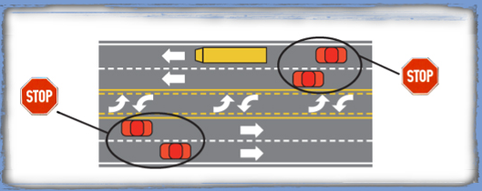
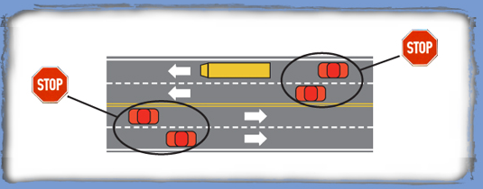

Slide 18
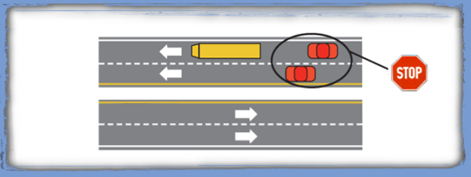

Slide 19


Determining Most Reasonably Safe Stop Locations (for discussion)
When known sexual offenders live in proximity:
  Should a temporary stop be established?
  Will it be to either side of the S/O address (at least 200 feet away)?
  Should the student’s walk route going past the sexual offender’s residence even be a consideration?
  If the S/O is located in a cul-de-sac and there is no other solution, should the district inform parents of students on the cul-de-sac about the location of the S/O?
  Do you periodically inform school bus drivers about the proximity of sexual offenders along their routes?

Slide 20
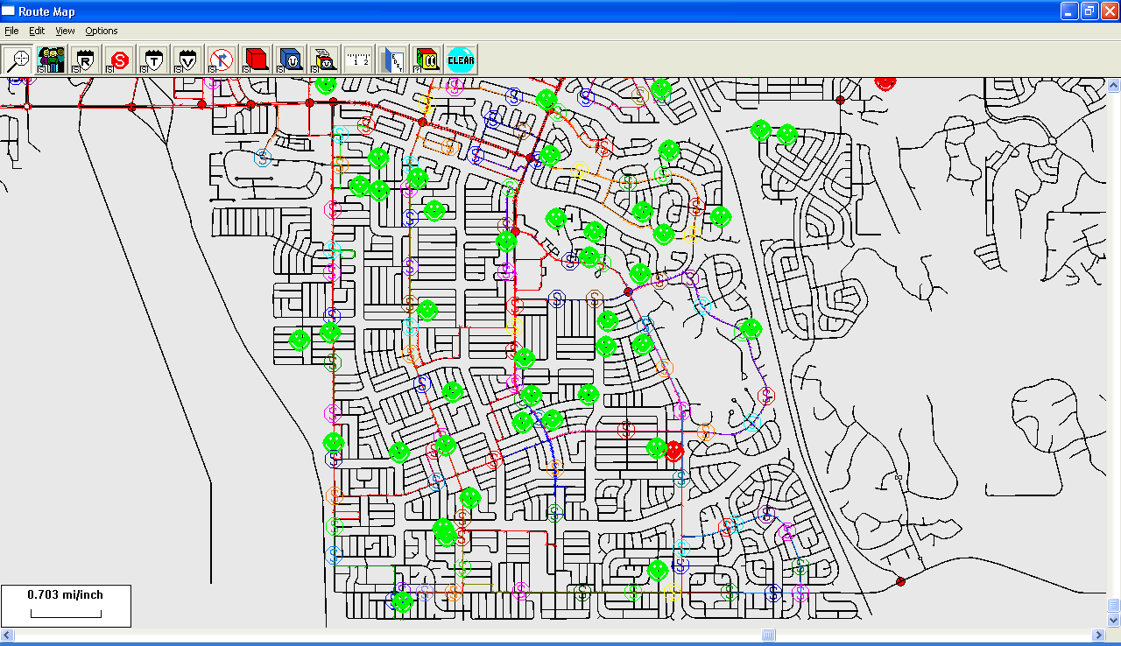
Transportation Geographic Information System Sex Offender Snapshot

Slide 21
Determining Most Reasonably Safe Stop Locations (for discussion)
If there is known criminal / gang activity in the area, should district:
  Discuss it with school resource officers and/or local authorities?
  Establish walk route and stop location policies consistent with those pertaining to proximity of sexual offenders?

Slide 22

Determining Most Reasonably Safe Stop Locations (for discussion)
If there is temporary construction creating a potential hazard, should district:
  Place a temporary stop (e.g., at entrance of subdivision)?
  Concern itself with the stop location only, or consider the walk route to and from?

Slide 23
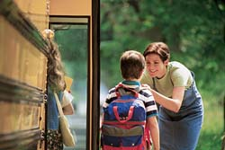
Determining Most Reasonably Safe Stop Locations (for discussion)
For students who live on cul-de-sacs, should district consider:
  Locating the stop only near the entrance/exit (not require bus travel down cul-de-sac)?
  Turning radius and whether bus can negotiate without backing?
  If backing is required, what procedural safeguards are needed?
  Never allow bus to back unless students get on first (AM) or remain on bus (PM)

Slide 24
Determining Most Reasonably Safe Stop Locations (for discussion)
When considering stops near RR crossings, should district consider:
  Requiring that stop be at least X distance from tracks and crossing (e.g., 1/10 mile)?
  Placing stops where no student is required to cross on foot to get to or from stop?

Slide 25
Determining Most Reasonably Safe Stop Locations (for discussion)
When locating stops near intersections, should district consider:
  Placing stop before, after, or in intersection?
  Avoiding stop located adjacent to a right turn or acceleration lane?
  Adjusting route to avoid stops near intersections?
  Avoiding location that requires bus to maneuver away from stop and change lanes to make left turn?

Slide 26
Consider locating stops at least 50 feet before entering an intersection or at least 200 feet following an intersection, maintaining at least 200 feet of uninterrupted visibility between the front and rear of the bus and other motorists.
Stops Near Intersections
50 feet
200 feet
Notes:
Because operators must give 200 feet advanced warning for a stop to load or unload students, stops at controlled intersections should be 200 feet following the intersection.
Because the alternating flashing amber lights must be activated 200 feet in advance of the stop, stops must be at least 200 feet apart.
The roadside can have an effect on bus stop locations. The roadside must be sufficiently clear so students have room to wait safely off the roadway.
The district school board has the responsibility of establishing bus routes, bus stop locations, and passenger lists. The superintendent of schools or someone under his/her direction usually handles this responsibility.
Operators should establish or change stops only with their supervisor’s permission.

Slide 27


Determining Most Reasonably Safe Stop Locations (for discussion)
When planning stops for students with special needs, should district:
  Evaluate duration of stop and potential motorist frustration if stopping on public street?
  Provide “curb-to-curb” or “door-to-door” stops or neither, based on student need and IEP?
  Assess the safety of the surface for loading and unloading (smoothness, level or inclined, etc.)?

Slide 28
What’s Wrong with These Pictures?
Next…

Slide 29
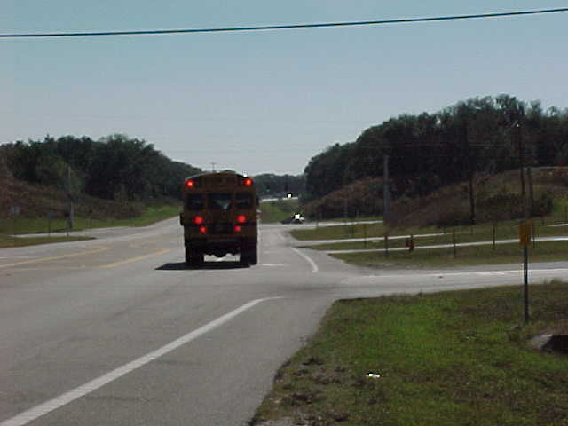

Slide 30
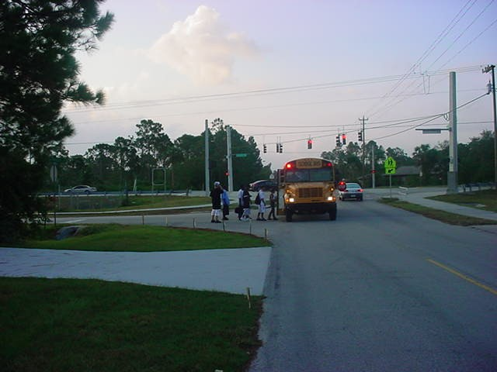

Slide 31
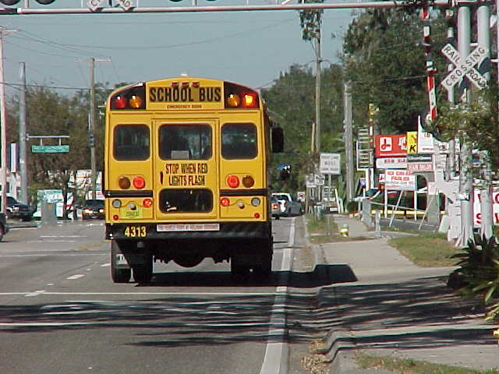

Slide 32
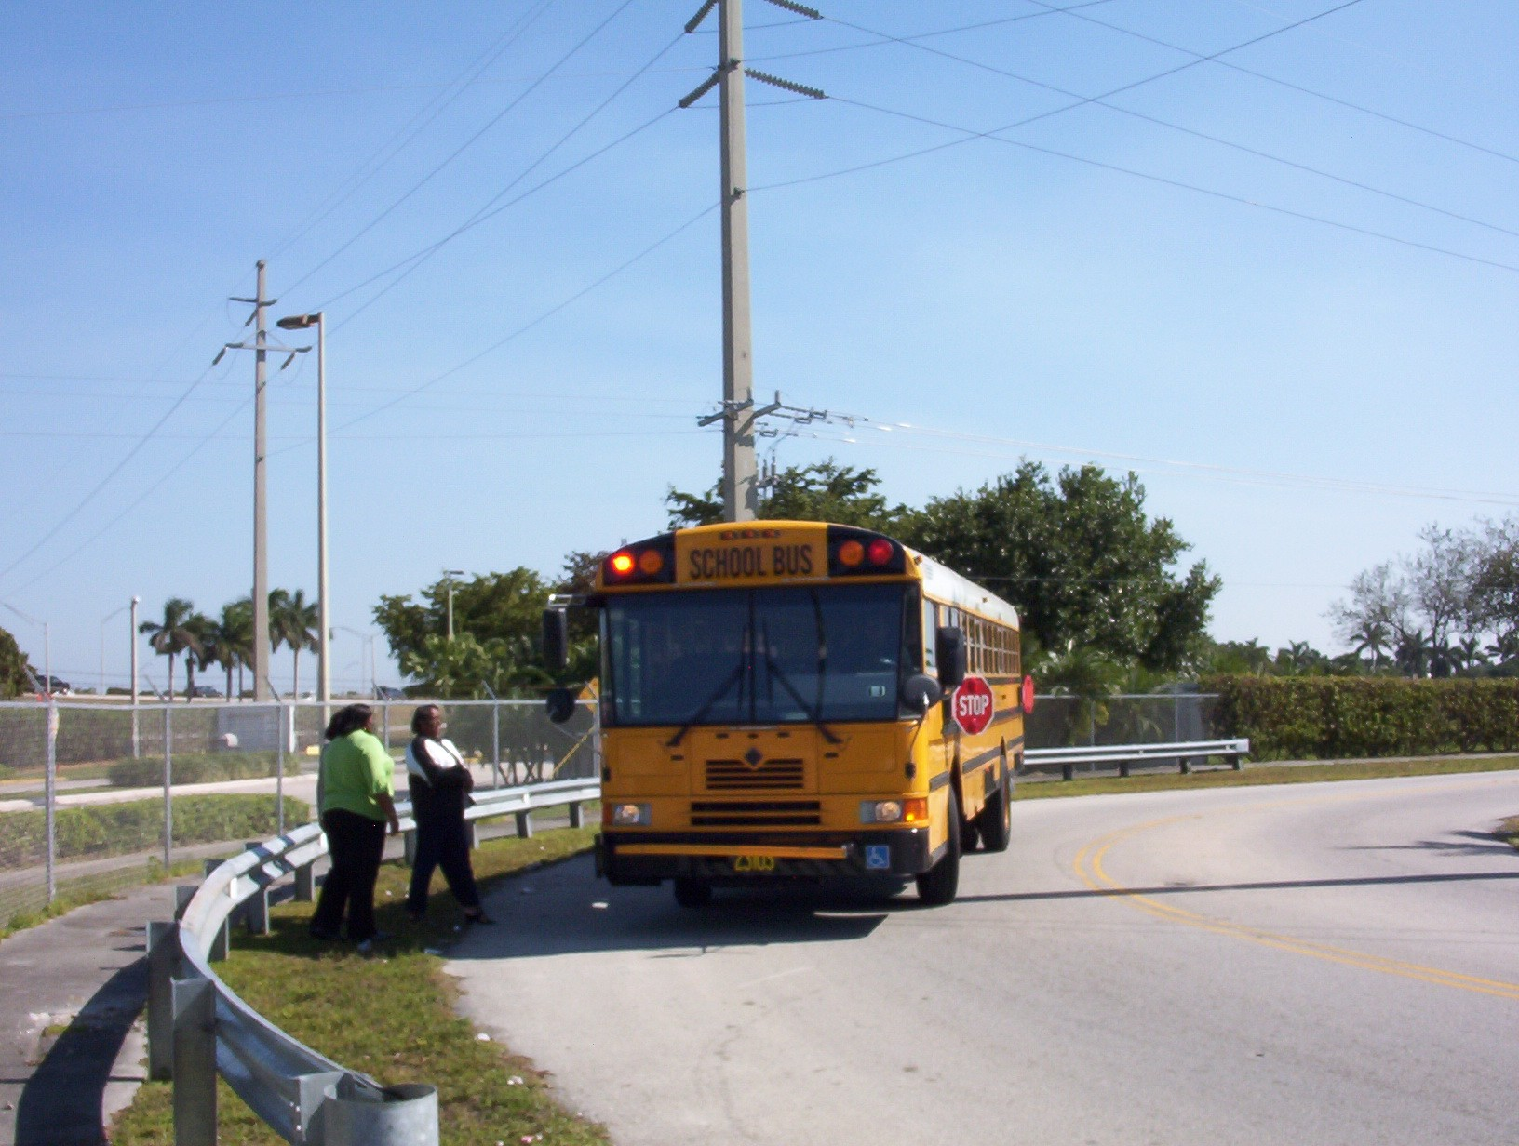

Slide 33

Date: __________________________
Dear Parent or Guardian,
It has come to our attention that a registered sex offender’s address is located in your neighborhood. At GCPS, the safety of our students is the utmost priority. Whenever possible, bus stops are established to prevent students from walking past a registered sex offender’s address.
However, in your neighborhood the sex offender’s address is located at or in a cul-de-sac, an apartment complex, or a hotel/motel/extended stay. As a result, we are unable to place a stop in a location that will prevent the students from walking past the address.
This letter is to inform you of where the closest stop is located and to ask you to ensure that your child gets to and from the bus stop safely.
The address of the closest bus stop:______________________________________
If you have any questions you can go to the GBI web site (see below) or contact the Gwinnett County Sheriff’s Department.
GBI web site: http://www.ganet.org/gbi/sorsch.cgi

Slide 34

Date: ______________________
Dear Parent or Guardian,
This letter is to inform you that temporary stops are being created in your neighborhood due to the fact that a registered sex offender is residing in your area.
As one of our criteria for determining the safety of GCPS bus stops, we ensure that we have a bus stop set on either side of a known sex offender’s address whenever possible. This allows students to access their assigned stop without having to cross in front of the sex offender’s residence.
In the event that the registered sex offender moves from this address, the bus stops will revert back to the original stops set for your neighborhood. The safety of the students is our top priority and we ask for your vigilance to ensure that your child gets to and from the bus stop safely.
Please note the address of the temporary stop, listed below, which your child will need to use until further notice.
Temporary Stop: ______________________________________________________
Thank you in advance for your cooperation in this matter.
If you have any questions you can go to the GBI web site (see below) or contact the Gwinnett County Sheriff’s Department.
GBI web site: http://www.ganet.org/gbi/sorsch.cgi

Slide 35
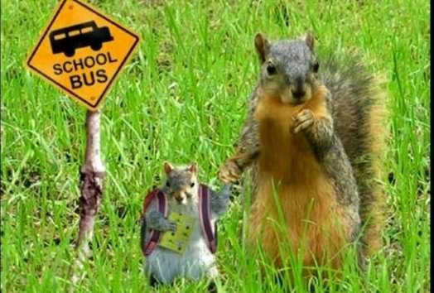
We All Want Safe Stops

Slide 36

It’s all about the kids!

Slide 37
Charlie Hood
ExecDir@nasdpts.org
(850) 274-4308
(with thanks to Don Moore, Gwinnett County, GA, for letting me update his 2008 presentation to SESPTC)

