Slide 1
KPI: Decision Making and Problem Solving
Charleston, WV – July 11, 2016
John W. Hazelette, CDPT
NAPT Region 2 Director

Slide 2
OBJECTIVES
Discuss the basics on how to institute and use KPIs in your operation
Emphasize the impacts this methodology can have on a program
Share examples of self performance vs peer analysis
Review definitions of KPIs/NAPT 3D
Moving from Data to Insight

Slide 3

Key Performance Indicator
A key performance indicator is simply defined as a measure of performance or

Slide 4
Key Performance Indicator
A measurable value that demonstrates how effectively you are achieving your key objectives

Slide 5
KPI Best Practices
Measuring and monitoring your performance is critical BUT, focusing on the wrong KPI can be detrimental
The right KPIs for your operation should follow these guidelines:

Slide 6
The Six A’s of KPI Best Practices
ALIGNED
Make sure the KPIs you use align with the strategic goals & objectives of your department/district

Slide 7
The Six A’s of KPI Best Practices
ATTAINABLE
What you choose to measure should have data that can be easily attained

Slide 8
The Six A’s of KPI Best Practices
ACUTE
KPIs should keep everyone on the same page – moving in the same direction

Slide 9
The Six A’s of KPI Best Practices
ACCURATE
The data in the KPI must be reliable and accurate

Slide 10
The Six A’s of KPI Best Practices
ACTIONABLE
Does the KPI give you insight that is actionable

Slide 11
The Six A’s of KPI Best Practices
ALIVE
Your operation is constantly changing– your KPIs should as well

Slide 12
How Do You Find/Select the Right KPI
Must have a good understanding of your operation and its objectives
Translate objectives into measurable goals
Select KPIs for each goal

Slide 13



Acknowledgements

Slide 14
KPIs allow us to:
Identify problem areas in our operation
Measure our progress at correcting those areas
Demonstrate the efficiency and
effectiveness of our programs

Slide 15
Many Possible KPIs
Average Age of Fleet
Cost per Mile
Cost per Student
On-time Performance
Crashes/accidents (miles between/miles between preventable)
Bus Usage – Runs per Bus
Notes:
It’s all in how you capture the data, i.e. cost per mile, how do you apply that cost? To total miles? To home-to-school? Include deadhead?

Slide 16
Many Possible KPIs (Con’t)
Equipment KPIs
Miles per Bus (Contractor/District)
Ride Times (Regular Ed/Special Ed)
Personnel – Turnover rate/Drivers per Supervisor/Drivers per Trainer
Buses per mechanic

Slide 17
Identify and focus response to internal/external questions
What issue are we trying to solve?
absences, overtime, bus capacity questions
Who will benefit from this data
understanding the data & audience (internal/public/Board)
Which information is needed?
is report high level or detailed? Fuel consumption, ridership?
When (what is the time period)?
prior fiscal year, last 5 years, by month, by day

Slide 18
First we know, then we show!
How are we doing?
How do we compare against our own track record?
How do we compare with others?
Are we making progress? Is it enough?
Are we using best practices?

Slide 19

How do we compare against others?

Slide 20

Caution
Apples to Apples
Many factors to consider…
  Types of programs being
  offered
  School choice
  Ride time policies
  Bus capacity policies
  Home to stop distance requirements
  Urban vs. rural

Slide 21
Students Transported Annually
Virginia School/Peer Divisions
2010/11-2012/13 SY
SCHOOL DIVISION | 2010/11 | 2011/12 | 2012/13
Study School Div. | 3,204 | 3,453 | 3,451
Peer Division 1 | 2,351 | 2,554 | 2,528
Peer Division 2 | 3,702 | 3,823 | 3,684
Peer Division 3 | 4,109 | 3,258 | 3,261
Peer Division 4 | 3,893 | 3,910 | 3,950
Peer Division Avg. | 3,514 | 3,386 | 3,356
Notes:
Discus the importance of peer divisions

Slide 22
Regular Ed Students
Virginia School/Peer Divisions
2012-13 SY
SCHOOL DIVISION | PUPILS | BUSES | AVG PUPILS PER BUS
Study School Div. | 3,389 | 82 | 41.33
Peer Division 1 | 2,441 | 65 | 37.55
Peer Division 2 | 3,613 | 69 | 52.36
Peer Division 3 | 3,187 | 91 | 35.02
Peer Division 4 | 3,880 | 92 | 42.17
Peer Division Avg. | 3,280 | 79 | 41.78
I
Notes:
Ridership KPI…

Slide 23
Cost per Mile
Regular and Exclusive Students
Virginia School/Peer Divisions
2012/13 SY
SCHOOL DIVISION | REGULAR STUDENT COST PER MILE | EXCLUSIVE STUDENT COST PER MILE
Study School Div. | $2.42 | $4.30
Peer Division 1 | $2.11 | $2.81
Peer Division 2 | $2.29 | $2.29
Peer Division 3 | $1.34 | $2.19
Peer Division 4 | $2.18 | $3.17
Peer Division Avg. | $1.98 | $2.72
Notes:
Cost KPI

Slide 24

How do we compare against our on track record?
Notes:
For me, this is where to start…find the data you have or start collecting what you need and build your data base

Slide 25
Ride Time for Regular Buses
Virginia School Division
2013-14 SY
SCHOOL | # OF BUSES | AVG RIDE TIME (MINUTES) | # OF BUSES OVER 60 MIN
HS | 22 | 60.05 | 10
MS | 39 | 48.87 | 8
ES 1 | 13 | 42.46 | 0
ES 2 | 15 | 39.67 | 0
ES 3 | 10 | 40.10 | 0
Notes:
District goal is 60 minutes…dig deeper to see that there are 10 buses exceeding that. What can I do??

Slide 26
KPI Example: Runs per bus
KPI: How many runs do your buses do each day
Benchmark: I should get at least 4 runs per day per bus (2 tier schedule)
Best Practice: How do I get to this number?
Notes:
Lets look at what these look like all together
KPI: How many runs does the average bus do each day
Benchmark: How does that compare to my peers?
Best Practice: How do I increase this number?

Slide 27
Regular Ed Students
Idaho School Division
Runs per Route
Total # of Routes | Total # with 4 Runs | % of Routes with 4 Runs
39 | 37 | 95%
Notes:
This is a 2 tier system…2 runs in the AM and 2 runs in the PM

Slide 28
Bus Capacity Analysis
Route Capacity
Capacity | 0 - 25% | 26%-50% | 51% - 75% | 76% -100%
Number of Routes (37) | 2 | 9 | 16 | 10
Notes:
How do you figure bus capacity? Well, in this district they use 50 per run. HS & MS paired together and ES separate. Conservative??? Perhaps for ES. So even with using a conservative number you can see that only 10% of the routes are at 76-100% capacity. Looks like more study is required

Slide 29
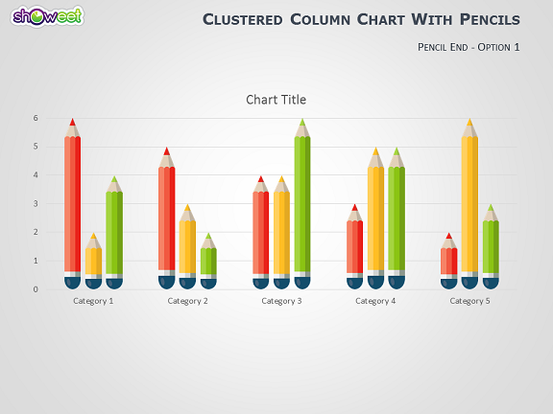
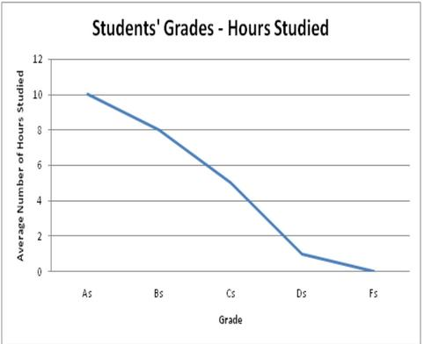
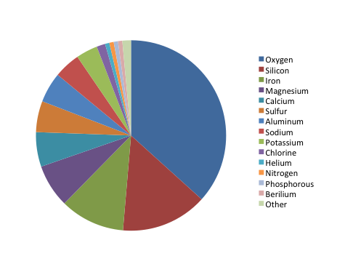
Use Data to Tell Your Story!

Slide 30
  Made up of 70 large city school districts
  Performance Management & Benchmarking Project began in 2002 to:
    Establish a common set of KPIs in a range of big city school operations
    Benchmark and compare the performance of the nations largest urban public school systems on KPIs
    Use the results to improve operational performance

Slide 31
Notes:
Go to CGCS website

Slide 32

Data Driven Decisions
3D.NAPT.ORG

Slide 34
Eligible Rider
A student who is eligible for district provided transportation based upon district policy
(walk to school distance, boundary, hazard, state or federal requirements)

Slide 35
Actual Rider
A student who rides on a home-to-school, school-to-home run
(whether they ride just to school or just home)

Slide 36
Scheduled Run
A run that is scheduled daily, or on a recurring basis to transport students to or from school (does not include activity or athletic runs)

Slide 37
Total Buses
All operating buses including route, spare, standby and activity buses

Slide 38
Scheduled Buses
Buses scheduled to support the scheduled runs (spare buses or standby buses should not be counted)

Slide 39
Spare Buses
A bus that is not used on a regular route but is a fully functioning bus – fueled, inspected and compliant with state guidelines.
A spare is not assigned a daily route but is available for immediate use when necessary

Slide 40
Average Age of Fleet
Calculate the vehicle age of all vehicles, add the ages together and divide by the number of total buses.
Vehicle age is identified by the date the vehicle was placed in service. If unsure of the in service year, use the model year

Slide 41
Total Annual Miles
The aggregate (total) miles driven by the pupil transportation fleet for providing services for transporting pupils to/from school, activities, field trips, shuttles, and related services including deadhead miles

Slide 42
Total To/From Annual School Miles
The total route miles driven for transporting pupils to, from or between schools for educational purposes. (Loaded and Deadhead)
This does include daily planned educational shuttle routes and does not include activity or field trips

Slide 43
Annual Training Hours, Bus Driver
The sum of all time used annually to train drivers. Include student management, safety, driving skills, district policies, etc. This also includes the average training hours that occur on multi-year schedules.
Example: The State required school bus driver 8 hour re-certification every 2 years. This would average 4 hours per year, which should be added to the total training hours.

Slide 44
Infusing Government with a Data-Driven Culture
http://www.governing.com/blogs/bfc/col-infusing-government-data-driven-culture-philadelphia-michael-nutter.html

Slide 45


Moving from Data to Insight
A Business Intelligence PRIMER
www.naptbi.com

Slide 46
Business Intelligence DEFINED
Business intelligence (B.I.)
B.I. is a technology-driven process for analyzing data and presenting actionable information to help executives, managers and other end users make more informed business decisions.
B.I. involves having a web platform for the acquisition and transformation of raw data into meaningful and useful information to identify business needs and determining solutions to business problems.
B.I. combines data from the industry (external data) with data from your organization (internal data) to provide a more comprehensive picture which creates “business intelligence" that cannot be derived by a singular set of data.

Slide 47
Business Intelligence PROCESS
IDENTIFY KEY ISSUES AND CREATE AN ONLINE WORKING GROUP
SHARE BEST PRACTICES TO GAIN BUSINESS INTELLIGENCE TO DEVELOP INITIATIVES
IMPLEMENT THE INITIATIVES TO ACHIEVE TARGETED RESULTS
BUSINESS
INTELLIGENCE
LEVEL
VIEW TREND DATA TO IDENTIFY PERFORMANCE PATTERNS
COMBINE METRICS TO CREATE NEW PERSPECTIVES & GAIN NEW KNOWLEDGE
OBTAIN OTHER DISTRICT DATA, MAKE COMPARISONS & GAIN NEW INSIGHTS
INSIGHT
LEVEL
CUT & PASTE, ENTER THEN UPLOAD THE DATA INTO A PORTAL
VALIDATE DASHBOARD & METRICS INFORMATION
REVIEW THE DATA TO GAIN AWARENESS OF THE PERFORMANCE DYNAMICS
INFORMATION
LEVEL
DATA LEVEL
IDENTFY THE REQUIRED DATA
IDENTFY THE SOURCES FOR THE DATA
COLLECT THE DATA

Slide 48
Questions?
John W. Hazelette, CDPT
Hazelette Consulting
jhazelette@cox.net

